Slide 1
My Hopes:
You develop at least one research idea today
You talk to a colleague and improve a research question today

Slide 2
Most of us are “Practitioner-Researchers”
Identify a problem to be studied
Collect data on the problem
Organize, analyze, and interpret the data
Develop a plan to address the problem
Implement the plan
Evaluate the results of the actions taken
Identify a new problem
Repeat the process
https://www.edglossary.org/action-research/

Slide 3
Part 1: Thinking of Interesting Research Topics
Rule #1: Do NOT read the literature
…..YET!

Slide 4
Part 1: Thinking of Interesting Research Topics
“If it ain’t broke, break it!”
“If it ain’t broke, don’t fix it?”
Zaltman G. Breaking out of the box: meaning and means. Adv Consum Res. 1997; 24123-9

Slide 5
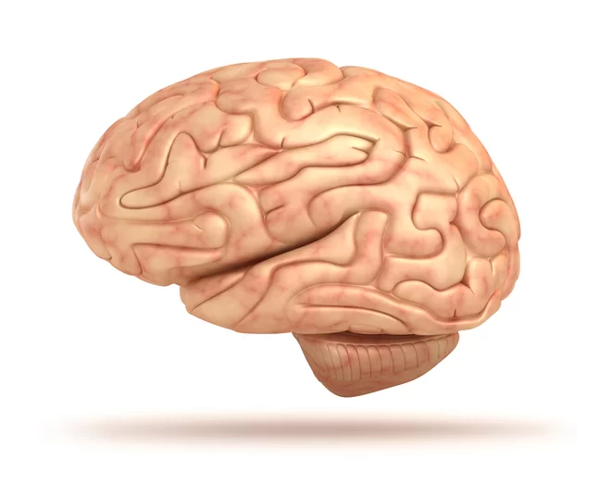
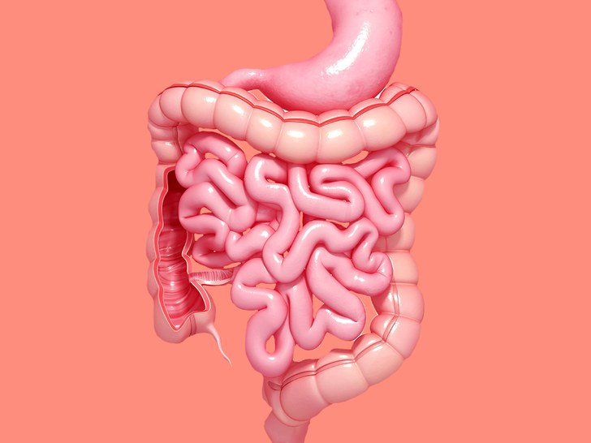
Part 1: Thinking of Interesting Research Topics
X
Intellect
Emotion
= “Cool Passion!”
Problems experienced in practice
Poor outcomes
Resource issues
Why do we do “xyz” that way?
Explain trends or anomalies
Outside issues impacting the field?
New or revised curriculum?
What makes me uncomfortable/mad/sad about this?
What about the status quo do I disagree with?
What questions would cause mischief!?
Does anyone else care?

Slide 6
Your Turn….. Let’s brainstorm some interesting research topics that would be important to our community. E.g., Dr Cendan’s recent awards: Real time assessment of professionalism Improving high stakes decisions about student progress

Slide 7
Part 2: The Research Purpose/Question (Not all interesting topics make good research questions!)
NOW read the literature:
Does the work need to be done?
Is this work significant? Justifiable?
What gap in knowledge will your project fill?
Can similar work inform the study design?
What theoretical models could be used to scaffold your study?
Are you equipped to do this kind of study? (If not, collaborate!)

Slide 8
The purpose of this study is to……
Overarching declarative statement
Neutral language (no presumed associations)
Variables of interest and context are stated
Clear, concise.
Examples:
The purpose of this study is to develop an understanding of the sources and impacts of trust or mistrust of the faculty and curriculum among preclinical medical students at the UCF COM.
The modified SOAP note assessment tool is capable of assessing the highest levels of Bloom’s taxonomy: analysis, synthesis and evaluation. The purpose of this study is to determine whether the SOAP note tool has sufficient reliability and validity to be used for high stakes assessment decisions in preclinical medical courses.

Slide 9
Your Turn (select one topic): The purpose of your study is to……
Overarching declarative statement
Neutral language (no presumed associations)
Variables of interest and context are stated
Clear, concise.

Slide 10
Hypothesis-Driven (Quantitative) Research
“A research hypothesis is a specific, clear, and testable proposition or predictive statement about the possible outcome, such as presumed differences between groups on a particular variable or relationships between variables.”
Use of hypotheses implies you will be using inferential statistics!
When you write a hypothesis you should have decided on the research design and what statistical tests you will use!

Slide 11
The specific hypotheses are….
Purpose:
The purpose of this study is to determine whether the SOAP note tool has sufficient reliability and validity to be used for high stakes assessment decisions in preclinical medical courses.
Hypotheses:
1. The SOAP tool will have a reliability coefficient (internal consistency) of at least 0.7 to demonstrate that grades are mathematically defensible.
2. Pairs of faculty raters will achieve intraclass correlations in excess of 0.7 to demonstrate acceptable inter-rater reliability.
3. SOAP scores will correlate with other summative assessment scores to demonstrate concurrent and predictive validity.
4. Survey ratings for faculty and students will be better than neutral to demonstrate acceptability, feasibility and cost-effectiveness.
5. Student SOAP scores will correlate with long term retention of knowledge after one year, as evidence of educational impact.

Slide 12
Research questions and specific aims (qualitative research)
Convert your purpose statement into a research question:
The purpose of this study is to develop an understanding of the sources and impacts of trust or mistrust of the faculty and curriculum among preclinical medical students at the UCF COM.
What are the sources of trust and mistrust between preclinical medical students and faculty at the UCF COM and how does this perception of trust impact the learning environment?

Slide 13
Research questions and specific aims (qualitative research)
What are the sources of trust and mistrust between preclinical medical students and faculty at the UCF COM and how does this perception of trust impact the learning environment?
Specific aims:
To describe the state of the student-faculty relationship
To assess the level of trust placed on the faculty and the curriculum.
To identify potential sources of trust and mistrust between students and faculty.
To determine the impacts on the learning environment of this level of trust or mistrust.
Note: In qualitative research the question can evolve during the study!

Slide 14
Fix the following research question. Why is active learning effective?
Can you suggest some specific aims or hypotheses…
Perhaps you are: Describing/measuring facts about a phenomenon Matching facts to a theory Comparing two models Evaluating if one method is more effective than another.. Etc…

Slide 15
Now you have a question, some downstream suggestions for success…
Decide on the research paradigm/design
Use theoretical frameworks/models where possible (grounded theory aside)
Plan data collection and quality control
Describe data analysis in detail
Ethics and IRB
Contemplate limitations
Make a plan for dissemination – abstracts/presentation then a full paper
Make a realistic time frame and stick to it!

Slide 16
Some (Informally cited) Source References
http://methods.sagepub.com/ - Research hypotheses
Gerald Zaltman (1997) ,"Breaking Out of the Box: Meaning and Means", in NA - Advances in Consumer Research Volume 24, eds. Merrie Brucks and Deborah J. MacInnis, Provo, UT : Association for Consumer Research, Pages: 12-14.
Carlisle C (1994) Writing a research proposal. Nurse Researcher 2, 1, 24-33,
Lusk SL (2004) Developing an outstanding grant application. Western Journal of Nursing Research. 26, 3, 367-373
Earlene E. Lipowski. Developing great research questions American Journal of Health-System Pharmacy, Volume 65, Issue 17, 1 September 2008, Pages 1667–1670, https://doi.org/10.2146/ajhp070276
Jane Agee (2009) Developing qualitative research questions: a reflective process, International Journal of Qualitative Studies in Education, 22:4, 431-447, DOI: 10.1080/09518390902736512

