Slide 1
Mixed Methods Research: Looking Beyond the Numbers
Presented by Dr. Anya Andrews, Associate Professor of Medicine, Director of Research Initiatives, UCF College of Medicine

Slide 2
Objectives
Review the basic characteristics and principles of mixed methods research
Explore qualitative research genres, methods, and software tools
Discuss applications of mixed methods research in medical education and academic medicine

Slide 3
Mixed Methods Research
Paradigms of Research Inquiry
Quantitative Research
Qualitative Research
Systematic empirical investigation of observable phenomena via statistical, mathematical, or computational techniques
Aims to measure, generalize, and maximize objectivity
Systematic empirical investigation of a social or human problem, based on building a complex, holistic picture using words representing views of informants, typically in a natural setting
Aims to understand, describe, and interpret

Slide 4
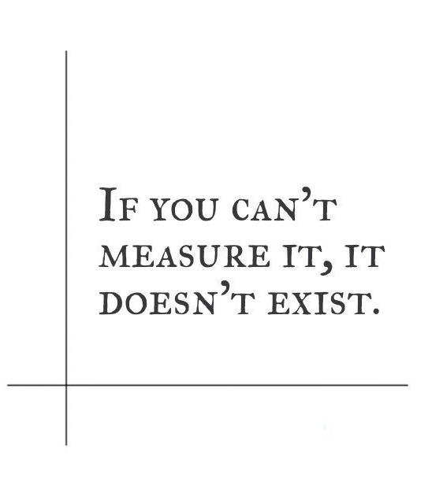
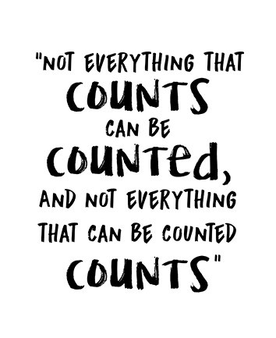
Which argument resonates with you more?
Probably not by Bill Gates
Probably not by Albert Einstein

Slide 5

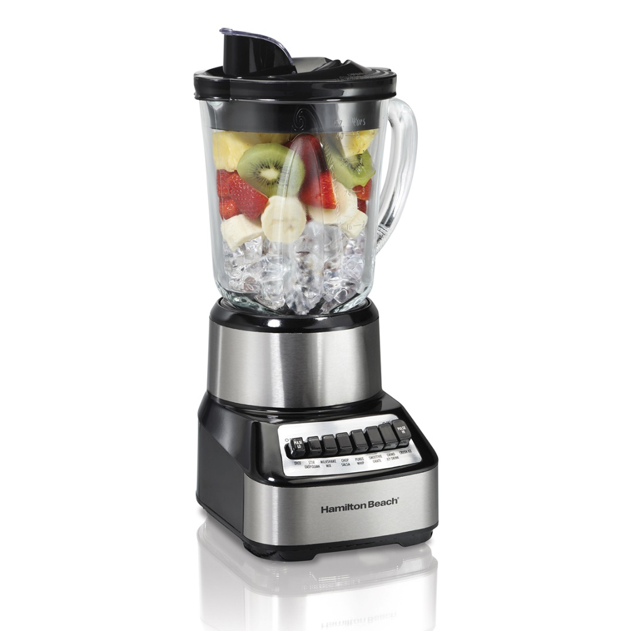
Quantitative + Qualitative: to mix or not to mix?
Complement each other well
Allow to glean a more complete multi-dimensional picture of the studied phenomena
Enhance research validity
Numbers without narratives are empty
Numbers can lie
Incompatible (“incompatibility thesis”)
Fundamental epistemological differences
Too complex and time consuming
Narratives without numbers are blind
Numbers don’t lie!

Slide 6
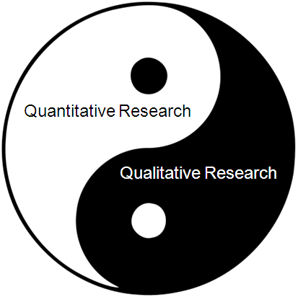
Why Use Mixed Methods Research?
Ask broader, bolder questions
Qualify the quantitative results
Quantify the qualitative results
See a bigger picture

Slide 7
Before you decide, start with a research question…
Example: To what extent and in what ways do interprofessional student learning experiences serve to contribute to their nuanced understanding of teamwork in healthcare and predict their success in clinical practice during clerkship and residency?
Quantitative
Implications
Qualitative
Implications

Slide 8

The “Seashell” Metaphor
Diverse, colorful, unique objects created as a protective outer layer by their inhabitants (currently alive or not)
Their organic composition and non-random patterns are influenced by the environment
An important part of the eco-system where they belong
Brittle but hardy, they hold clues for what lies beneath the surface

Slide 9
Qualitative Research Principles
Study social, relational, and experiential phenomena in natural settings by observing and interacting with the people and places
Seeks to understand and represent complexity and offer a richly textured account of social or human phenomena
How and What questions
Aims for a careful understanding of instances, contextualization, and theory building

Slide 10


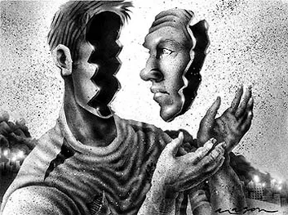

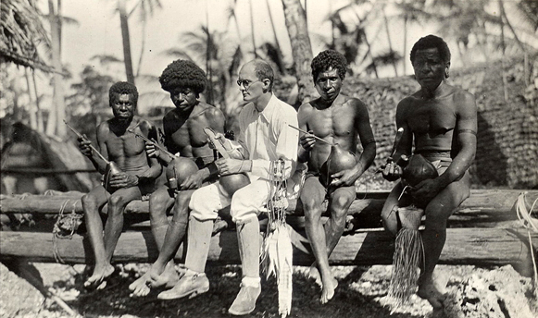



Qualitative Research Methodologies/Genres
Biography
Phenomenology
Grounded Theory
Case Study
Ethnography
Narrative/Storytelling
Hermeneutics*
Action Research*

Slide 11
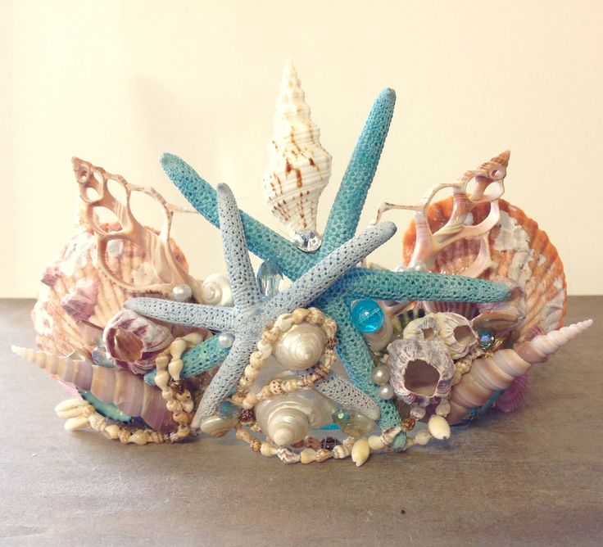
Qualitative Research Methods: Data Collection
Interviews (structured, semi-structured, in-depth)
Focus groups
Observations
Assembly of textual documents (including researcher’s field notes and reflections)
Note: Qualitative data collection and analysis frequently occur simultaneously and are always closely linked.

Slide 12



Qualitative Research Methods: Data Analysis
Coding
Thematic Analysis
Discourse Analysis
Interpretation and Writing
What is the unit of coding?
How do they fit together?
What is the “story” that must be told?

Slide 13
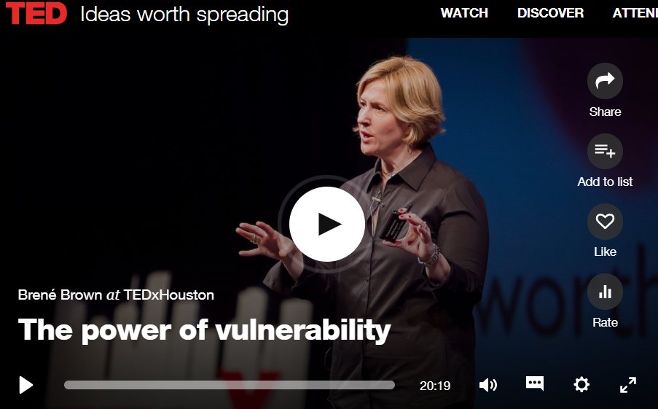
In the words of a qualitative researcher…
“The Power of Vulnerability” - A TED Talk by Brene Brown, Ph.D., Research Professor,
University of Houston, Endowed Chair at the Graduate College of Social Work

Slide 14

From Brene’s example, QR is about…
Storytelling -“stories are data with a soul”
Expanding perception
Making sense of the “messy side of life”
Unexpected discoveries and necessary “side trips”
Unpredictable study timeline
Large volumes of diverse data sets
Looking for data connections, themes, patterns, commonalities, linguistic origins
Intensive data analysis
Emotional engagement leading to a shift in perspectives
Notes:
Storytelling, collecting stories, which are “data with a soul”
Expanding perception
Studying the “messy side of life” and trying to understand and make sense of it
Unexpected discoveries throughout the research process, which may require research “side trips” for additional exploration to deconstruct the elements of phenomena
Unpredictable study timeline
Large volumes of diverse data sets
Looking for data connections, themes, patterns, commonalities, linguistic origins and bringing it all together through an intensive data analysis (“data immersion”)
Emotional engagement in research frequently leading to a shift in perspectives

Slide 15
Principles of Rigor
Adequacy and appropriateness of the sample
Quality of the data collected
Authenticity and reflexivity of data collection, e.g., triangulation
Clarity of the analysis process, e.g., audit trails
Appropriate use of theory, e.g., theory as a lens or a product

Slide 16

Quantifying Qualitative Data: Turning the data from words/images into numbers
Count findings that provide quantifiable answers
Count proportions while exploring relationships between data categories
Examine differences in responses by using statistical procedures
Compare/correlate with the quantitative data set
Test the degree of quantitative concordance with quantitative studies and national data
Visualize your qualitative data
“The ways, in which qualitative data can be collected and analyzed, are virtually infinite.”
(Guest, MacQueen, & Namey, 2011.)

Slide 17
Challenges of Mixed Methods Research
A time and resource-consuming endeavor
Diverse competency requirements for investigator(s)
Different core criteria for quality assessment
Aspect | Quantitative Term | Qualitative Term
Truth value | Internal validity | Credibility
Applicability | External validity and generalizability | Transferability
Consistency | Reliability | Dependability
Neutrality | Objectivity | Confirmability

Slide 18

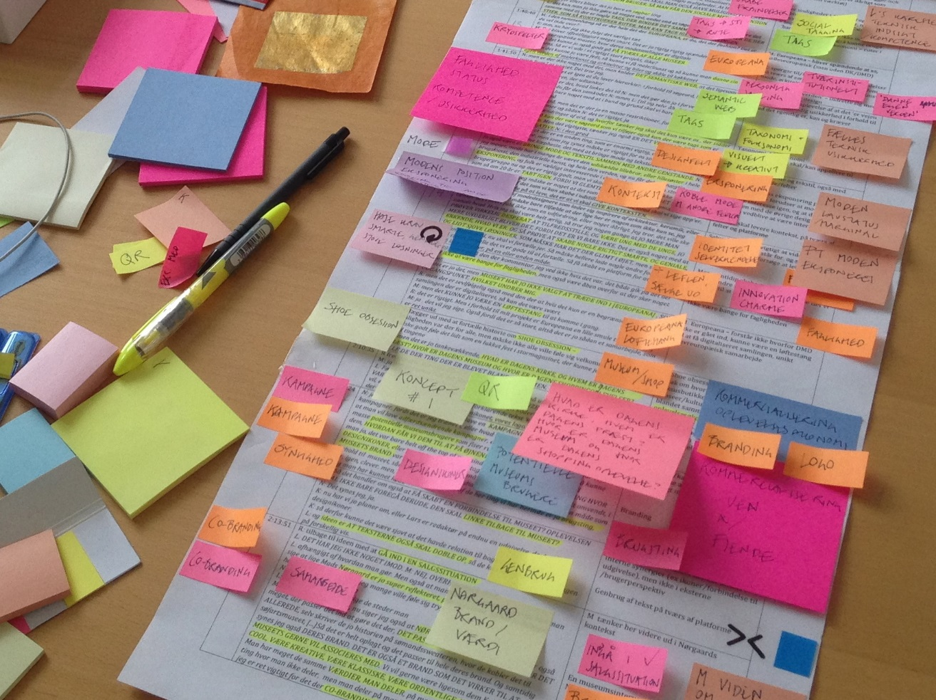
Anything worth doing…

Slide 19
Computer-Assisted Qualitative (and Mixed) Data Analysis Software (CAQDAS) Tools
Specific to Qualitative Research
Qualitative and Mixed Methods Research Friendly
Nvivo
ATLAS.ti
webQDA
QDA Miner
MAXQDA
HyperRESEARCH
Dedoose

Slide 20
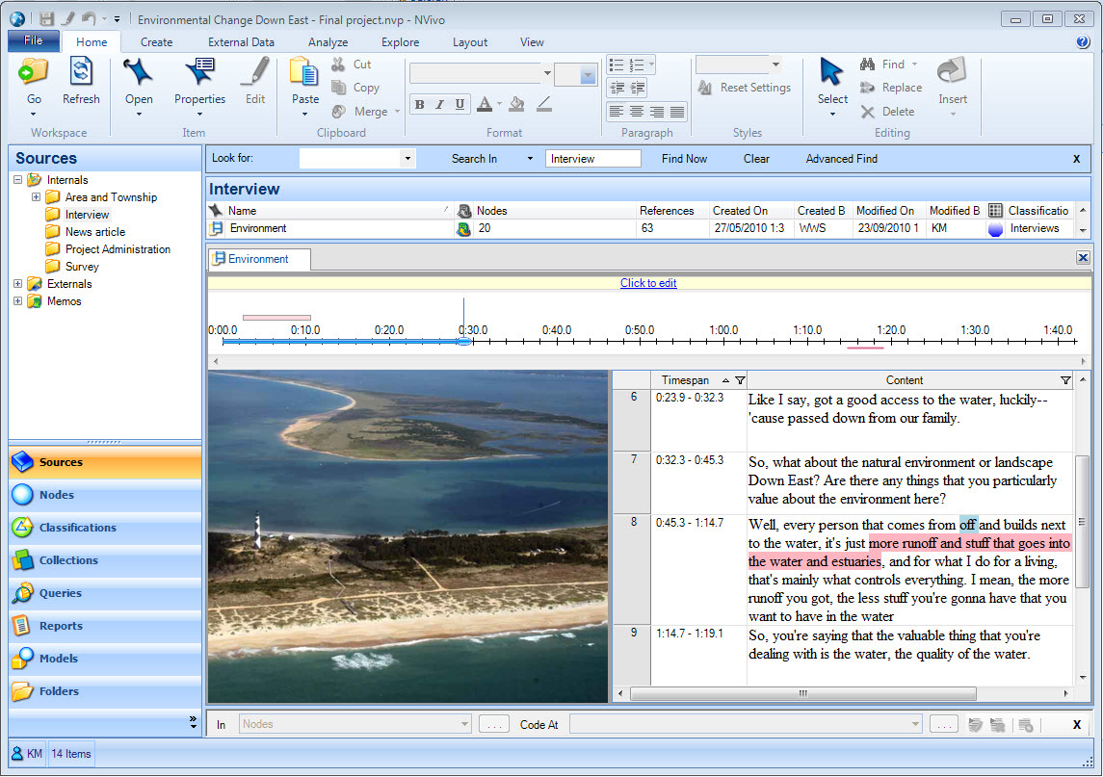
NVivo Example

Slide 21
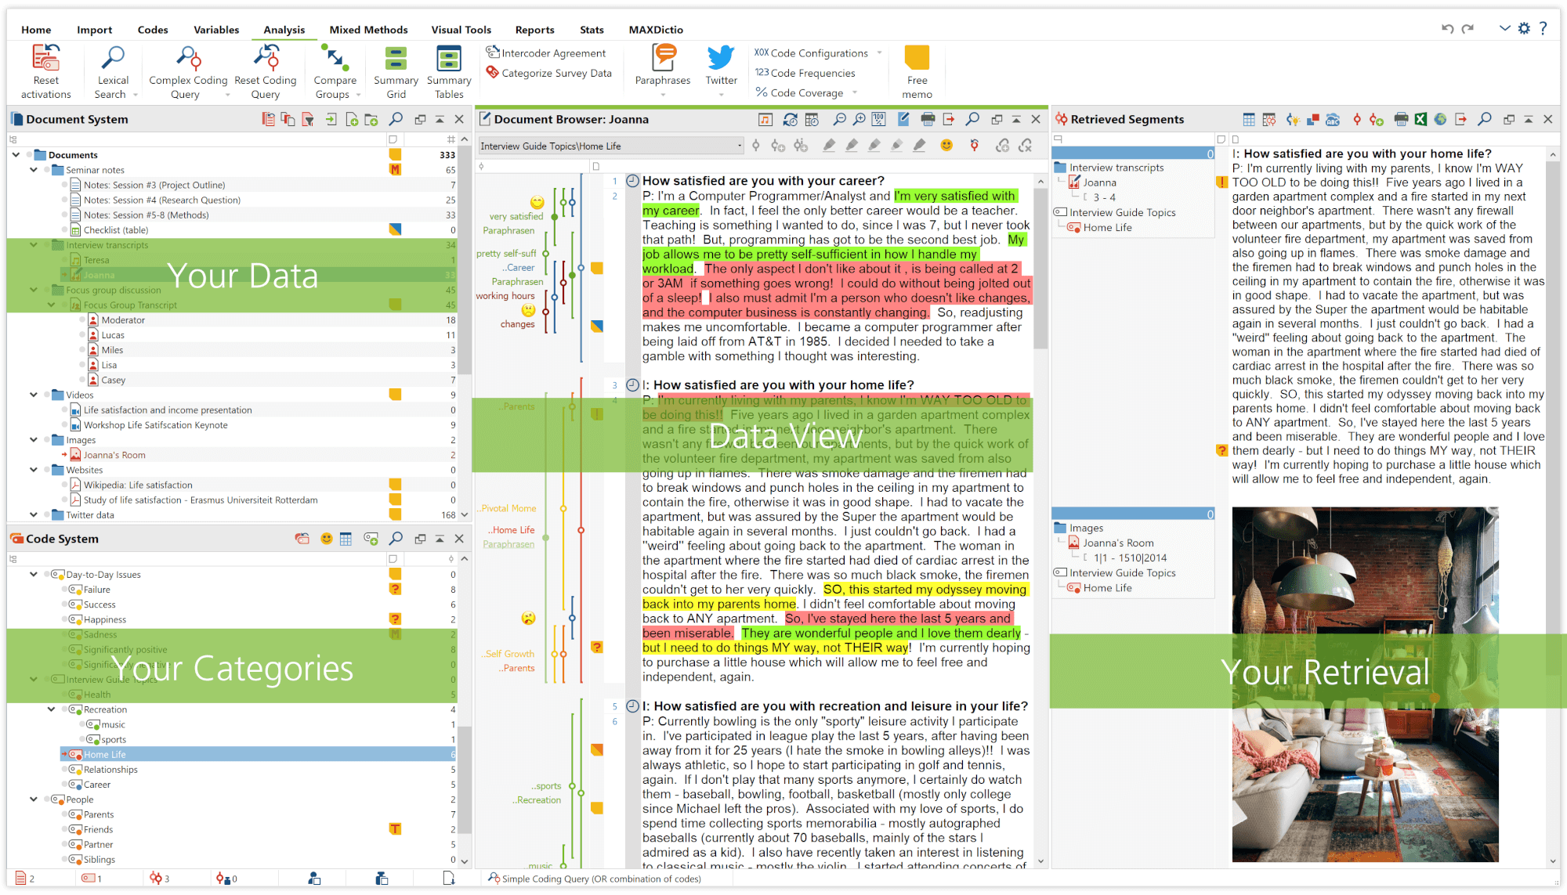
MAXQDA Example

Slide 22
Disseminating Mixed Methods and Qualitative Research
Journal of Mixed Methods Research (traditional)
Qualitative Research in Medicine & Healthcare (open access)
Qualitative Health Research (combination)
International Journal of Qualitative Methods (open access)
Mixed Methods International Research Association (MMIRA)

Slide 23
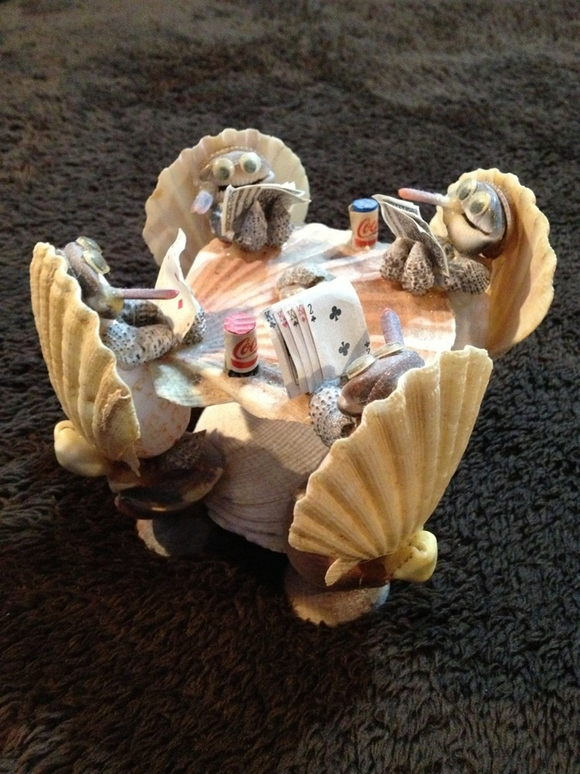
Conclusions and Takeaways
Always start with a research question in mind
Use the “best fit” methodology and methods for the research questions you wish to answer
Employ CAQDAS software tools to manage volumes of data and ensure research quality
Be prepared to deliberate, not accelerate
Have Fun!

Slide 24
Good Reads
Creswell, J. W. (1998) Qualitative inquiry and research design: choosing among five traditions. Sage Publications.
Miles, M. B. & Huberman, A.M. (1994) Qualitative data analysis. Sage Publications.
Rossman, G. B. & Rallis, S. F. (2003). Learning in the field: an introduction to qualitative research. Sage Publications
Olson, K., Young, R. A. Schultz (2016, eds.) Handbook of qualitative health research for evidence-based practice. Springer.
Curry, L. & Nunez-Smith, M. (2014) Mixed methods in health sciences research: a practical primer. Sage Publications.

Slide 25

Questions?

Slide 26
Thank you!

