Slide 1
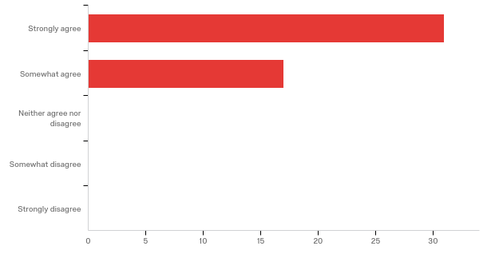
After completing ACLS or PALS training I feel like I am better prepared for the first day of my residency program?

Slide 2
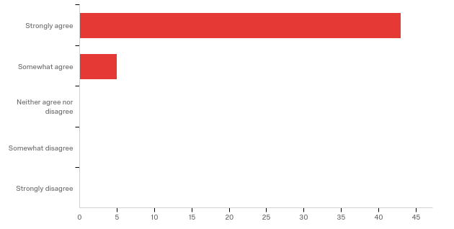
ACLS or PALS training was a valuable education experience?

