Slide 1
Annual Faculty Council Meeting
October 16, 2017

Slide 2
Meeting Agenda
4:00-4:05 Introduction by Faculty Council President
(VP & Immediate Past President)
4:05-4:10 Welcome new Faculty Members
4:15-4:25 Faculty Council Committees, Representatives & COM Senators & FC website
4:25-4:35 Last year’s accomplishments & this year’s goals
4:35-5:00 Dean German’ address and questions
5:00-5:10 Open Q & A Faculty Council President

Slide 3
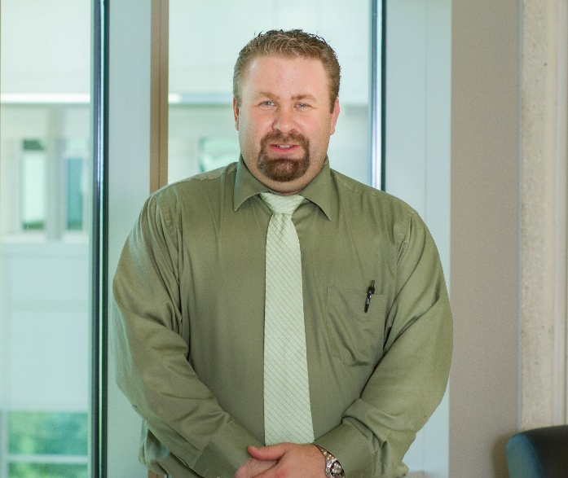
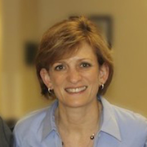
Faculty Council Leadership
Judy Simms-Cendan. MD
Immediate past president
Clinical Sciences
David Harris, PhD
Vice President
Medical Education

Slide 4
New Faculty Members

Slide 5
Welcome New Faculty Members!
Clinical Sciences
Katherine Daly, Psychology
Marcia Katz, Associate Dean of Clinical Affairs, Pulmonology
John Tramont, Obstetrics & Gynecology
Mehul Patel, Ophthalmologist
Obi Adigweme, General Surgery
Non-salaried core:
  W. Bryan Gamble, Plastic Surgery
  Relin Yang, Anesthesiology

Slide 6
Welcome New Faculty Members!
Internal Medicine
Anya Andrews, Interdisciplinary Research Development
Naveed Sami, Dermatologist
Cindy Gleit, Family Medicine
Aishah Ali, Allergist
Michael Seifert, Internal Medicine/Sports Medicine
Liz Arnold, Social Work (Secondary Joint)
Meirelys Castro, Family Physician
Non-salaried core
  Jeffrey Greenwald, Dermatology
  Mamta Mangal, Internal Medicine
Medical Education
Jeffrey LaRochelle, Internal Medicine
Feroza Daroowalla, Internal Medicine (Visiting)
Notes:
These individuals started after Aug 15, 2011

Slide 7
Welcome Faculty Members!
Burnett School of Biomedical Sciences/Divisions
Salvador Almagro-Moreno, Assistant Professor, Molecular Microbiology
Amber Southwell, Assistant Professor, Neuroscience
Hongxia Zhou, Assistant Professor, Neuroscience
Xugang Xia, Professor, Neuroscience
Xuan Chen, Assistant Scholar/Scientist
Lucia Morstadt, Assistant Scholar/Scientist
Alejandra Petrilli, Assistant Scholar/Scientist
Subhrangshu Guhathakurta, Assistant Scholar/Scientist
Kirsten Schroeder, Assistant Professor, Biomedical Sciences
Melissa Worley, Instructor
Notes:
These individuals started after Aug 15, 2011

Slide 8
Faculty Council & Committees https://med.ucf.edu/comfacultycouncil
Five Committees

Slide 9
COM Faculty Council Functions
Is the representative body of the COM faculty
Considers any matters brought before it by the faculty, Medical School Enterprise, or Dean
  Reviews policies and regulations that affect faculty
  Makes recommendations to the Dean, Enterprise Committee or groups as appropriate
  Selects members of ad hoc committees
Reports to the faculty on activities of the administration, Faculty Council, and standing committees

Slide 10
Leadership Committee
Purpose: Acts on behalf of the Faculty Council during intervals between Faculty Council meetings, reports all such actions to the faculty, formulates long-range goals of the council.
Members:
Cristina Fernandez-Valle, President (Burnett) – 2016-2019
David Harris, Vice President (Med Ed) – 2017-2020
Judith Simms-Cendan, (Clin Sci) Immediate Past President – 2015-2018
The Leadership Committee is part of the Executive Faculty which is part of the Enterprise & represents faculty interests at bimonthly Executive Faculty & Enterprise meetings & meets monthly with the Dean, & the FC representatives.
Vice-President is elected by the core faculty of the UCF COM and serves a 3 year term (VP, P, PP)

Slide 11
Past Presidents
Thanks To DR. STEVE EBERT, For Completing Three Years Of Service On FC Leadership Committee! He Joins The “Past Presidents Club” With Drs. Khaled, Gibson, King, Davey.
Thanks to SUZANNE STALVEY for outstanding administrative support!

Slide 12
FC Representative Committee
Faculty Council leadership plus elected members from
  Biomedical Sciences Main Campus Herve Roy, PhD
  Biomedical Sciences Lake Nona Jackie Zhao, PhD
  Medical Education Daniel Topping, PhD
  Clinical Sciences @ UCF Health Shazia Beg, MD
  Clinical Sciences not @ UCF Health Caridad Hernandez, MD
Members meet monthly with the Faculty Council leadership to discuss Faculty Council issues

Slide 13
Nominations Committee
Purpose: Prepares a list of candidates for FC Vice President, elected members of Faculty Advocate Committee, and FC Representative Committee
Members:
Judy Simms-Cendan, Chair (Clin Sci)
Steve Lambert (Med Ed)
Stephen King (BSBS)
Dinender Singla (BSBS)
Analia Castiglioni (IM)
Committee chaired by immediate past president, composed of two representatives from BSBS & two from departments within COM
Members appointed by Leadership Committee & names submitted to the Dean following vote by Leadership Committee
Members serve staggered three-year terms.

Slide 14
Committee on Committees
Purpose: Recommends candidates to fill vacancies on policy & administrative committees of the COM
Members:
Dave Harris, VP & Chair (Med Ed)
Mollie Jewett, (Burnett)
Sean Moore, (Burnett)
Dan Topping, (Med Ed)
Committee chaired by VP & composed of four additional members appointed by the Leadership Committee for representation from Schools & Departments within the COM.
Members appointed by Leadership Committee & names submitted to the Dean following vote by Leadership Committee
Members serve staggered three-year terms.

Slide 15
Faculty Advocate Committee
Purpose: receives, hears and makes recommendations to individual faculty and FC leadership committee on unresolved issues from that faculty member.
Members: (permanent 3-6 yrs)
Dan Topping (Med Ed)
Annette Khaled (Burnett)
Caridad Hernandez (IM)
Committee composed of six members. Three members are elected from a slate of candidates identified by the FC Nominating Committee. The electorate is the entire core faculty. Staggered three-year terms with potential for renewal for a total of six years of service, one member replaced each year.
The remaining three members are appointed by FC Leadership Committee & identified on a case-by-case basis and only serve for the duration of that case.

Slide 16
Bylaws Committee
Purpose: shall annually review bylaws, consider proposed changes, and make recommendations regarding such changes to the Faculty Council.
Members:
Debopam Chakrabarti, (Burnett)
Yoon Kim, (Burnett)
Manette Monroe, (Clin Sci)
Bernard Gros, (IM)
Diane Davey, (Clin Sci)
Committee is composed of core faculty members with proportional representatives from COM units.
Committee has five members appointed by the FC Leadership committee after consultation with the Committee on Committees. The President of the FC designates the Chair.

Slide 17
UCF Faculty Senate
UCF Faculty Senate is the basic legislative body of the University.
The Senate is the primary voice of the faculty and serves as the main channel of communication between faculty members and administration.
It is an advisory body to the president and provost and, as such, participates in shared governance.
Its committees provide academic oversight by reviewing and approving policies, new courses, course changes, new programs and program revisions. Senate leaders meet informally with the provost and administration, to discuss issues and find informal solutions when appropriate.
The UCF Faculty Senate may also pass formal resolutions to express a stand on issues or call for action.

Slide 18
ROLE OF UCF-COM SENATORS
Serve as the primary channel of communication between COM faculty members and the UCF central administration.
Service on university committees and councils is the primary means of direct participation in university governance by COM faculty.
These committees carry out Senate and university business that impacts COM.

Slide 19
UCF Faculty Senate
Committees and Councils
  5 Operational
  8 Curricular
  16 Joint

Slide 20
College Of Medicine Senators
Bill Self, (Burnett) President Faculty Senate
Steve Lambert, (Med Ed) Graduate Appeals
Steve King, (Burnett) Personnel Chair
Laurel Gorman, CS/IM/ME SteeringCommittee
Kimi Sugaya, Member-at-Large, Budget & Admin Chair

Slide 21
Previous Year’s Accomplishments
Goal: “Serve UCF COM Faculty interests and goals”
  Worked with the administration to have UCF Board of Trustees REPEAL new regulation (UCF 10.010), “Discipline and Termination for Cause of Faculty and A&P Staff Members of the College of Medicine”
  Grievance Policy approved by COM enterprise
  Professional Statement incorporated into ByLaws
  Initiated Mentoring Lecture: Reshma Jagsi
  Faculty Awards & Faculty Awards Committee

Slide 22
Upcoming FC Objectives for 2017-18
Serve UCF COM Faculty interests and goals
  Provide an active forum for faculty concerns and share these with the administration
Promote transparency of process with respect to faculty issues
Amend bylaws as becomes needed as COM grows
Represent faculty interest related to:
  Teaching Hospital
  Academic Health Sciences Center Task Force
  Potential Merging of COHPA Units into Burnett School of Biomedical Sciences
  Space Planning, Analysis, and Administration of UCF

Slide 23
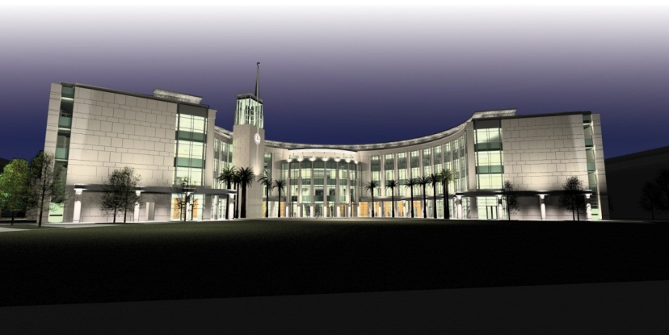
Dr. Deborah German
Dean of the UCF College of Medicine

Slide 24
THANK YOU!
Faculty Council Leadership
Cristina Fernandez-Valle, President- cfv@ucf.edu
David Harris, Vice President- David.Harris@ucf.edu
Judith Simms-Cendan, Past President – Judith.Simms-Cendan@ucf.edu
Faculty Council Representative Group
Jackie Zhao, Biomedical Sciences
Herve Roy, Biomedical Sciences
Shazia Beg, Clinical Sciences
Caridad Hernandez, Clinical Sciences
Dan Topping, Med Ed
Faculty Council Support Staff
Suzanne Stalvey, Clinical Sciences comfacultycouncil@ucf.edu

Slide 25
Open Question Time
???

